Slide 1
Maximum Flow Network

Slide 2
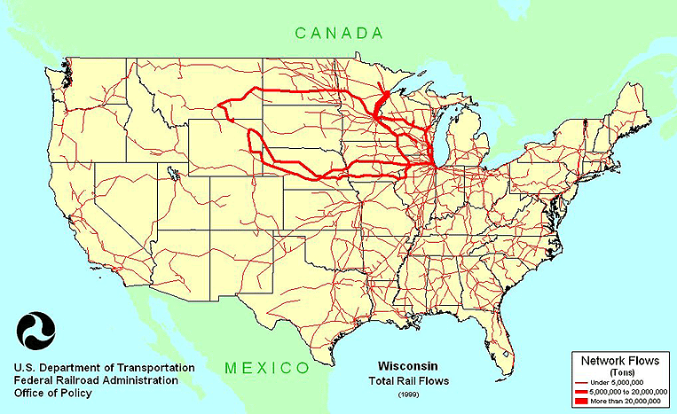
Network Flows

Slide 3
Types of Networks
Internet
Telephone
Cell
Highways
Rail
Electrical Power
Water
Sewer
Gas
…

Slide 4
Maximum Flow Problem
How can we maximize the flow in a network from a source or set of sources to a destination or set of destinations?
The problem reportedly rose to prominence in relation to the rail networks of the Soviet Union, during the 1950's. The US wanted to know how quickly the Soviet Union could get supplies through its rail network to its satellite states in Eastern Europe.
In addition, the US wanted to know which rails it could destroy most easily to cut off the satellite states from the rest of the Soviet Union. It turned out that these two problems were closely related, and that solving the max flow problem also solves the min cut problem of figuring out the cheapest way to cut off the Soviet Union from its satellites.

Slide 5
Network Flow
Instance:
A Network is a directed graph G
Edges represent pipes that carry flow
Each edge (u,v) has a maximum capacity c(u,v)
A source node s in which flow arrives
A sink node t out which flow leaves
Goal: Max Flow
5

Slide 6
The Problem
Use a graph to model material that flows through conduits.
Each edge represents one conduit, and has a capacity, which is an upper bound on the flow rate, in units/time.
Can think of edges as pipes of different sizes.
Want to compute max rate that we can ship material from a designated source to a designated sink.

Slide 7
What is a Flow Network?
Each edge (u,v) has a nonnegative capacity c(u,v).
If (u,v) is not in E, assume c(u,v)=0.
We have a source s, and a sink t.
Assume that every vertex v in V is on some path from s to t.
e.g., c(s,v₁)=16; c(v₁,s)=0; c(v₂,v₃)=0

Slide 8
What is a Flow in a Network?
For each edge (u,v), the flow f(u,v) is a real-valued function that must satisfy 3 conditions:
Notes:
The skew symmetry condition implies that f(u,u)=0.
We show only the positive flows in the flow network.

Slide 9
Example of a Flow:
capacity
flow
capacity
f(v₂, v₁) = 1, c(v₂, v₁) = 4.
f(v₁, v₂) = -1, c(v₁, v₂) = 10.
f(v₃, s) + f(v₃, v₁) + f(v₃, v₂) + f(v₃, v₄) + f(v₃, t) =
0 + (-12) + 4 + (-7) + 15 = 0

Slide 10
The Value of a flow
The value of a flow is given by
This is the total flow leaving s = the total flow arriving in t.

Slide 11
Example:
|f| = f(s, v₁) + f(s, v₂) + f(s, v₃) + f(s, v₄) + f(s, t) =
11 + 8 + 0 + 0 + 0 = 19
|f|= f(s, t) + f(v₁, t) + f(v₂, t) + f(v₃, t) + f(v₄, t) =
0 + 0 + 0 + 15 + 4 = 19

Slide 12
A flow in a network
We assume that there is only flow in one direction at a time.
Sending 7 trucks from Edmonton to Calgary and 3 trucks from Calgary to Edmonton has the same net effect as sending 4 trucks from Edmonton to Calgary.

Slide 13
Multiple Sources Network
We have several sources and several targets.
Want to maximize the total flow from all sources to all targets.
Reduce to max-flow by creating a supersource and a supersink:

Slide 14
Residual Networks
The residual capacity of an edge (u,v) in a network with a flow f is given by:
The residual network of a graph G induced by a flow f is the graph including only the edges with positive residual capacity, i.e.,

Slide 15
Example of Residual Network
Flow Network:
Residual Network:

Slide 16
Augmenting Paths
An augmenting path p is a simple path from s to t on the residual network.
We can put more flow from s to t through p.
We call the maximum capacity by which we can increase the flow on p the residual capacity of p.

Slide 17
Augmenting Paths
Network:
Residual Network:
Augmenting path
The residual capacity of this augmenting path is 4.

Slide 18
Computing Max Flow
Classic Method:
Identify augmenting path
Increase flow along that path
Repeat

Slide 19
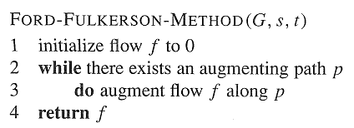
Ford-Fulkerson Method

Slide 20
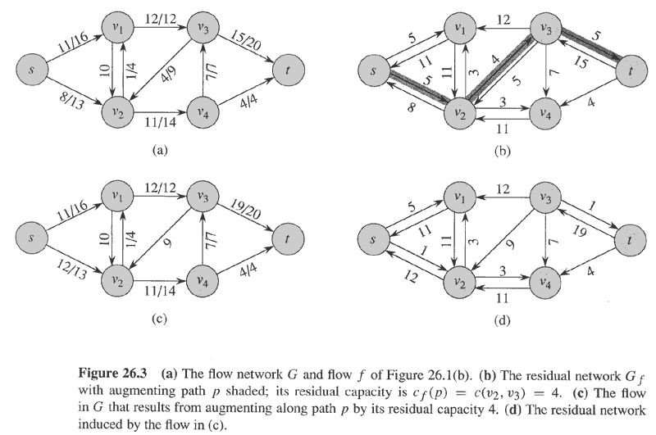
Example
Flow(1)
Residual(1)
No more augmenting paths → max flow attained.
Flow(2)
Residual(2)
Cut
20

Slide 21
Cuts of Flow Networks

Slide 22
The Net Flow through a Cut (S,T)
f(S,T) = 12 – 4 + 11 = 19

Slide 23
The Capacity of a Cut (S,T)
c(S,T)= 12+ 0 + 14 = 26

Slide 24
Augmenting Paths – example
Capacity of the cut
= maximum possible flow through the cut
= 12 + 7 + 4 = 23
Flow(2)
cut
The network has a capacity of at most 23.
In this case, the network does have a capacity of 23, because this is a minimum cut.

Slide 25
Net Flow of a Network
The net flow across any cut is the same and equal to the flow of the network |f|.

Slide 26
Bounding the Network Flow
The value of any flow f in a flow network G is bounded from above by the capacity of any cut of G.

Slide 27
Max-Flow Min-Cut Theorem
If f is a flow in a flow network G=(V,E), with source s and sink t, then the following conditions are equivalent:
f is a maximum flow in G.
The residual network G_{f} contains no augmented paths.
|f| = c(S,T) for some cut (S,T) (a min-cut).

Slide 28
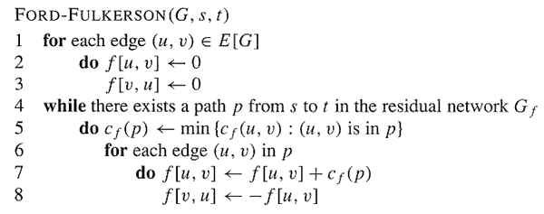
The Basic Ford-Fulkerson Algorithm

Slide 29
Example
augmenting path
Original Network
Flow Network
Resulting Flow =
4

Slide 30
Example
Resulting Flow =
Flow Network
4
augmenting path
Residual Network
Flow Network
Resulting Flow =
11

Slide 31
Example
Flow Network
Resulting Flow =
11
augmenting path
Residual Network
Flow Network
Resulting Flow =
19

Slide 32
Example
Flow Network
Resulting Flow =
19
augmenting path
Residual Network
Flow Network
Resulting Flow =
23

Slide 33
Example
Resulting Flow =
23
No augmenting path:
Maxflow=23
Residual Network

Slide 34
Analysis
O(E)
?
O(E)

Slide 35
Analysis
If capacities are all integer, then each augmenting path raises |f| by ≥ 1.
If max flow is f*, then need ≤ |f*| iterations → time is O(E|f*|).
Note that this running time is not polynomial in input size. It depends on |f*|, which is not a function of |V| or |E|.
If capacities are rational, can scale them to integers.
If irrational, FORD-FULKERSON might never terminate!

Slide 36
Maximum Bipartite Matching
A bipartite graph is a graph G=(V,E) in which V can be divided into two parts L and R such that every edge in E is between a vertex in L and a vertex in R.
e.g. vertices in L represent skilled workers and vertices in R represent jobs. An edge connects workers to jobs they can perform.

Slide 37
A matching in a graph is a subset M of E, such that for all vertices v in V, at most one edge of M is incident on v.

Slide 38
A maximum matching is a matching of maximum cardinality (maximum number of edges).
not maximum
maximum

Slide 39
A Maximum Matching
No matching of cardinality 4, because only one of v and u can be matched.
In the workers-jobs example a max-matching provides work for as many people as possible.
v
u

Slide 40
Solving the Maximum Bipartite Matching Problem
Reduce the maximum bipartite matching problem on graph G to the max-flow problem on a corresponding flow network G’.
Solve using Ford-Fulkerson method.
40

Slide 41
Corresponding Flow Network
To form the corresponding flow network G' of the bipartite graph G:
Add a source vertex s and edges from s to L.
Direct the edges in E from L to R.
Add a sink vertex t and edges from R to t.
Assign a capacity of 1 to all edges.
Claim: max-flow in G’ corresponds to a max-bipartite-matching on G.
G
→G’
1
1
1
1
1
1
1
1
1
s
1
1
t
1
1
1
1
L
R

Slide 42
Solving Bipartite Matching as Max Flow

Slide 43
Does this mean that max |f| = max |M|?
Problem: we haven’t shown that the max flow f(u,v) is necessarily integer-valued.
Integrality Theorem
If the capacity function c takes on only integral values, then:
The maximum flow f produced by the Ford-Fulkerson method has the property that |f| is integer-valued.
For all vertices u and v the value f(u,v) of the flow is an integer.
So max|M| = max |f|

Slide 44
Example
min cut
|M| = 3 max flow =|f|= 3

Slide 45
PUSH RELABEL ALGORITHM

Slide 46
Definitions (Push relabel)
Graph G = (V, E)
|V| = n
|E| = m
G is a flow network if it has
source s and sink t
capacity c(v,w) for each edge (v,w) in E
c(v,w) = 0 for (v,w) not in E

Slide 47
Definitions (continued)
A flow f on G is a real value function on vertex pairs
f(v,w) <= c(v,w) for all (v,w)
f(v,w) = -f(w,v)
∑_{u}f(u,v) = 0 for all v in V - {s,t}
Value of a flow |f| is ∑_{v}f(v,t)
Maximum flow is a flow of maximum value

Slide 48
Definitions (continued again)
A preflow f on G is a real value function on vertex pairs
f(v,w) <= c(v,w) for all (v,w)
f(v,w) = -f(w,v)
∑_{u}f(u,v) >= 0 for all v in V - {s}
Flow excess e(v) = ∑_{u}f(u,v)
Intuition: flow into a vertex can exceed flow out

Slide 49
Intuition & RESIDUAL GRAPH
Starting with a preflow, push excess flow closer towards sink
If excess flow cannot reach sink, push it backwards to source
Eventually, preflow becomes a flow and in fact the maximum flow
Residual capacity r_{f}(v, w) of a vertex pair is c(v, w) – f(v, w)
If v has positive excess and (v,w) has residual capacity, can push δ = min(e(v), r_{f}(v, w)) flow from v to w
Edge (v,w) is saturated if r_{f}(v, w) = 0
Residual graph G_{f} = (V, E_{f}) where E_{f} is the set of residual edges (v,w) with r_{f}(v, w) > 0

Slide 50
Labeling
A valid labeling is a function d from vertices to nonnegative integers
d(s) = n
d(t) = 0
d(v) <= d(w) + 1 for every residual edge
If d(v) < n, d(v) is a lower bound on distance to sink
If d(v) >= n, d(v) - n is a lower bound on distance to source

Slide 51
Push Operation
Push(v,w)
Precondition: v is active (e(v) > 0) and
r_{f}(v, w) > 0 and d(v) = d(w) + 1
Action: Push δ = min(e(v), r_{f}(v, w))
from v to w
f(v,w) = f(v,w) + δ; f(w,v) = f(w,v) – δ;
e(v) = e(v) - δ; e(w) = e(w) + δ;

Slide 52
Relabel Operation
Relabel(v)
Precondition: v is active (e(v) > 0) and
r_{f}(v, w) > 0 implies d(v) <= d(w)
Action: d(v) = min{d(w) + 1 | (v,w) in E_{f}}

Slide 53
Generic Push-Relabel Algorithm
Starting from an initial preflow
<<loop>>
While there is an active vertex
Chose an active vertex v
Apply Push(v,w) for some w or Relabel(v)

Slide 54
Example
0/1
0/3
0/2
S
T
Flow Network

Slide 55
Example
0
0/1
0
3/3
0/2
4
0
S
T
Initial preflow / labeling

Slide 56
Example
0
0/1
0
3/3
0/2
4
0
S
T
Select an active vertex

Slide 57
Example
1
0/1
0
3/3
0/2
4
0
S
T
Relabel active vertex

Slide 58
Example
1
0/1
0
3/3
0/2
4
0
S
T
Select an active vertex

Slide 59
Example
1
1/1
0
3/3
0/2
4
0
S
T
Push excess from active vertex

Slide 60
Example
1
1/1
0
3/3
0/2
4
0
S
T
Select an active vertex

Slide 61
Example
1
1/1
1
3/3
0/2
4
0
S
T
Relabel active vertex

Slide 62
Example
1
1/1
1
3/3
0/2
4
0
S
T
Select an active vertex

Slide 63
Example
1
1/1
1
3/3
1/2
4
0
S
T
Push excess from active vertex

Slide 64
Example
1
1/1
1
3/3
1/2
4
0
S
T
Select an active vertex

Slide 65
Example
5
1/1
1
3/3
1/2
4
0
S
T
Relabel active vertex

Slide 66
Example
5
1/1
1
3/3
1/2
4
0
S
T
Select an active vertex

Slide 67
Example
5
1/1
1
1/3
1/2
4
0
S
T
Push excess from vertex

Slide 68
Example
5
1/1
1
1/3
1/2
4
0
S
T
Maximum flow

Slide 69
Correctness
Lemma 2.1 If f is a preflow, d is a valid labeling, and v is active, either push or relabel is applicable to v
Lemma 3.1 The algorithm maintains a valid labeling d
Theorem 3.2 A flow is maximum iff there is no path from s to t in G_{f} (Ford and Fulkerson [7])

Slide 70
Correctness (continued)
Lemma 3.3 If f is a preflow and d is a valid labeling for f, there is no path from s to t in G_{f}
Proof by contradiction
Path s, v₀, v₁, …, v_{l}, t implies that
d(s) <= d(v₀) + 1 <= d(v₁) + 2 <= …
<= d(t) + l < n
Which contradicts d(s) = n

Slide 71
Correctness (continued)
Theorem 3.4 If the algorithm terminates with a valid labeling, the preflow is a maximum flow
If the algorithm terminates, all vertices have zero excess (preflow is a flow)
By Lemma 3.3 the sink is not reachable from the source
By Theorem 3.2 the flow is maximum

Slide 72
Termination
Lemma 3.5 If f is a preflow and v is an active vertex then the source is reachable from v in G_{f}
Lemma 3.6 A vertex’s label never decreases

Slide 73
Termination (continued)
Lemma 3.7 At any time the label of any vertex is at most 2n – 1
Only active vertex labels are changed
Active vertices can reach s
Path v, v₀, v₁, …, v_{l}, s implies that
d(v) <= d(v₀) + 1 <= d(v₁) + 2 <= …
<= d(s) + l <= n + n - 1

Slide 74
Termination (continued)
Lemma 3.8 There are at most 2n² labeling operations
Only the labels corresponding to V-{s,t} may be relabeled
Each of these n – 2 labels can only increase
At most (2n – 1) (n – 2) relabelings

Slide 75
Termination (continued)
Lemma 3.9 The number of saturating pushes is at most 2nm
For any pair (v,w) d(w) must increase by 2 between saturating pushes from v to w
Similarly d(v) must increase by 2 between pushes from w to v
d(v) + d(w) >= 1 on the first saturating push
d(v) + d(w) <= 4n - 3 on the last
At most 2n - 1 saturating pushes per edge

Slide 76
Termination (continued)
Lemma 3.10 The number of nonsaturating pushes is at most 4n²m
Φ = ∑_{v} d(v) where v is active
Each nonsaturating push causes Φ to decrease by at least 1
The total increase in Φ from saturating pushes is
(2n – 1) 2nm
The total increase in Φ from relabeling is
(2n – 1)(n – 2)
Φ is 0 initially and Φ at termination

Slide 77
Termination
Theorem 3.11 The algorithm terminates in O(n²m)
Total time =
# nonsaturating pushes
+ #saturating pushes
+ #relabeling operations
4n²m + 2nm + 2n² ⁼ O(n²m)

